Slide 1


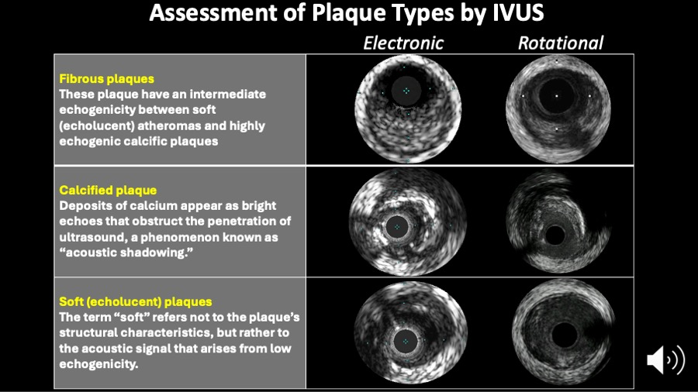

Intravascular ultrasound
Figure 5
Assessment of plaque types by intravascular ultrasound. The IVUS consensus paper definitions are shown on this slide.
Hector M. García-García, Fernando Alfonso
©2025 Europa Group - All rights reserved.

