Slide 1


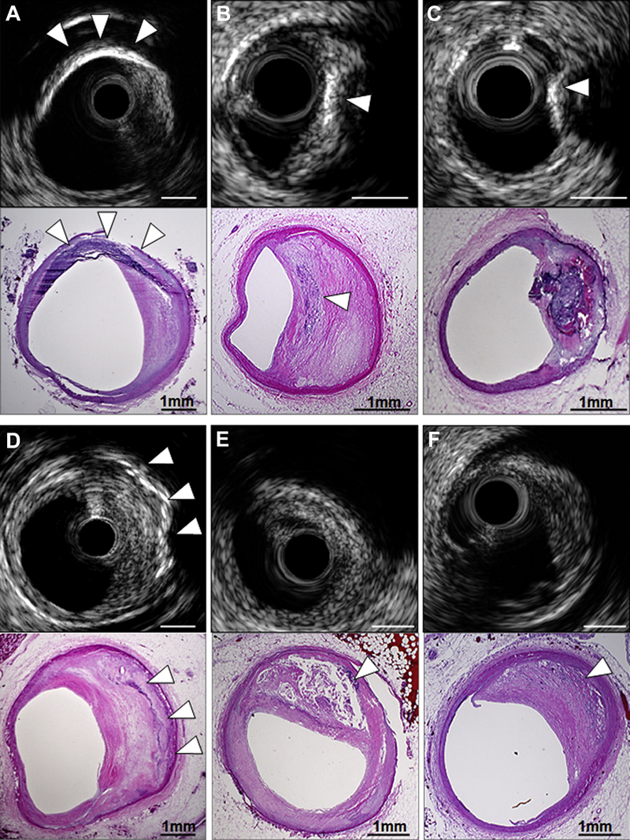

Intravascular ultrasound
Figure 6
Coronary calcification. In the upper examples, IVUS-detected segments with superficial calcification (white arrowheads) were seen to be calcified fibrous plaque (A), FA with spotty calcium (B), and calcified nodule (C) on pathological images. (D) IVUS detected deep calcium in the setting of calcified fibrous without overlying NC (white arrowheads); (E) conversely, IVUS failed to detect spotty calcium (white arrowhead) that was present pathologically, because it was hidden behind a large NC within a late FA that caused attenuation. (F) Finally, microcalcification (white arrowhead) within the NC of an early FA was not detected by IVUS but produced echo attenuation. Bar = 1 mm. FA, fibroatheroma; NC, necrotic core.
Hector M. García-García, Fernando Alfonso
©2025 Europa Group - All rights reserved.

