Slide 1


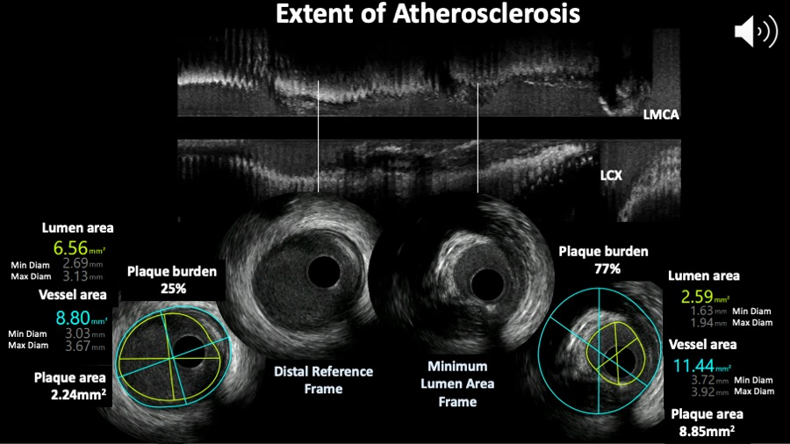

Intravascular ultrasound
Figure 7
Extent of atherosclerosis assessed by intravascular ultrasound. The top panel shows the longitunal view and two cross sections showing the minimum lumen area frame and reference site.
Hector M. García-García, Fernando Alfonso
©2025 Europa Group - All rights reserved.

