Slide 1


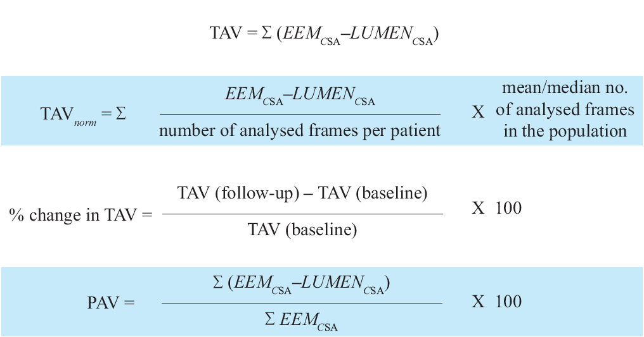

Intravascular ultrasound
Figure 8
Variables measured in progression/regression longitudinal IVUS studies. TAV is total atheroma value ; EEM is external elastic membrane ; PAV is percentage atheroma value.
Hector M. García-García, Fernando Alfonso
©2025 Europa Group - All rights reserved.

