Slide 1


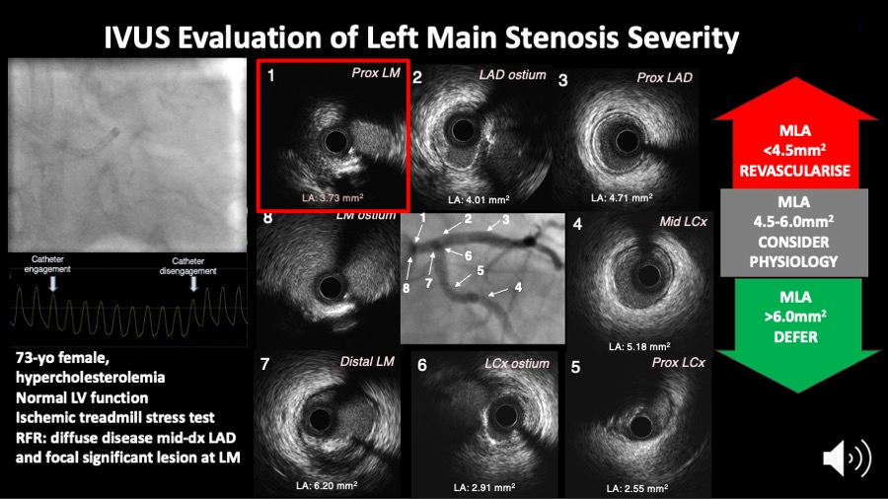

Intravascular ultrasound
Figure 9A
Figure 9A shows the IVUS assessment of a left main coronary artery stenosis. IVUS helps to measure the minimum lumen area which may inform the need for revascularisation as per the scheme on the right side of the figure.
Hector M. García-García, Fernando Alfonso
©2025 Europa Group - All rights reserved.

