Slide 1


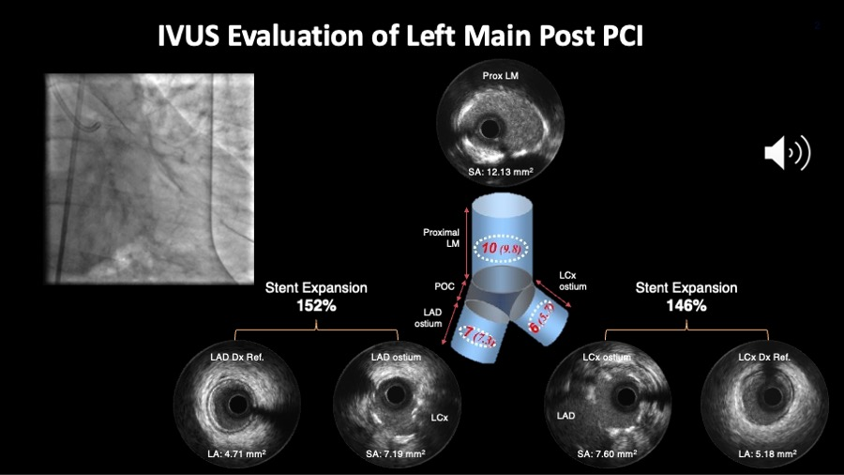

Intravascular ultrasound
Figure 9B
Figure 9B shows the angiography and IVUS results after the stenting. Important to check whether the proposed cut off values for minimum stent area in each segment are achieved. Alternatively, one can also look at the relative expansion index. Angiography and IVUS images are courtesy of Daniel Chamie.
Hector M. García-García, Fernando Alfonso
©2025 Europa Group - All rights reserved.

