Slide 1


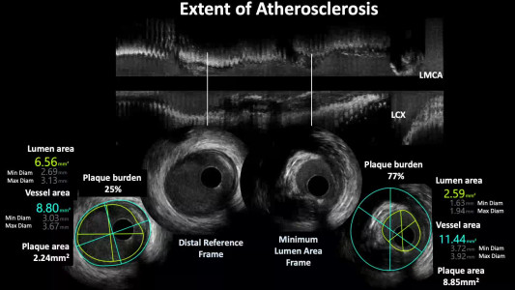

Intravascular ultrasound
Video Extent of atherosclerosis
Hector M. García-García, Fernando Alfonso
©2025 Europa Group - All rights reserved.

