Slide 1


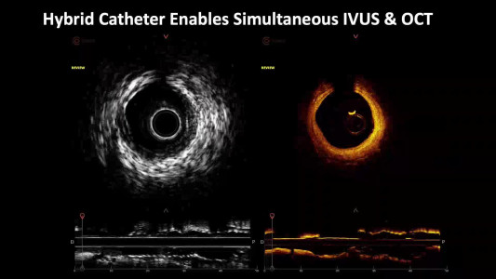

Intravascular ultrasound
Video Hybrid IVUS and OCT
Hector M. García-García, Fernando Alfonso
©2025 Europa Group - All rights reserved.

