Slide 1


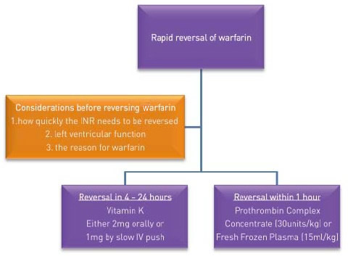

Invasive diagnostic coronary angiography
Figure 13
Algorithm for urgent reversal of warfarin
Guy R. Heyndrickx, Aaron Peace, Chrysafios Girasis, Christoph K. Naber, Patrick W. Serruys, Christos V. Bourantas
©2025 Europa Group - All rights reserved.

