Slide 1


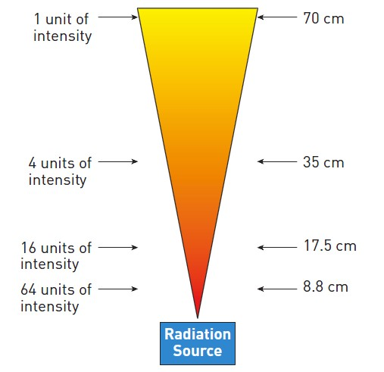

Invasive diagnostic coronary angiography
Figure 17
The effects of the inverse square law in radiation protection: the level of radiation is inversely proportional to the distance squared (permission Naber manuscript)
Guy R. Heyndrickx, Aaron Peace, Chrysafios Girasis, Christoph K. Naber, Patrick W. Serruys, Christos V. Bourantas
©2025 Europa Group - All rights reserved.

