Slide 1


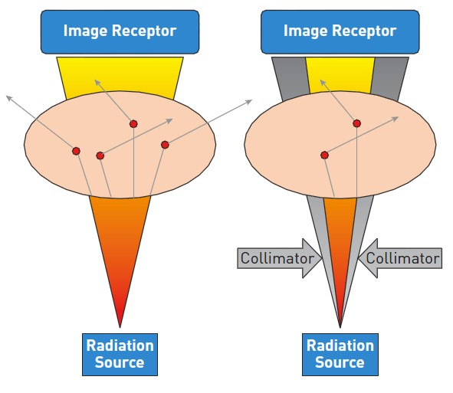

Invasive diagnostic coronary angiography
Figure 18
A collimator reduces the radiated volume and thus the amount of scatter radiation (permission Naber manuscript)
Guy R. Heyndrickx, Aaron Peace, Chrysafios Girasis, Christoph K. Naber, Patrick W. Serruys, Christos V. Bourantas
©2025 Europa Group - All rights reserved.

