Slide 1


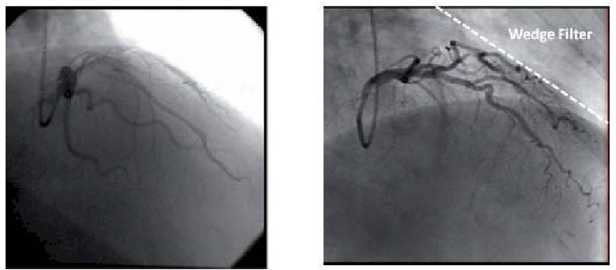

Invasive diagnostic coronary angiography
Figure 19
The use of wedge filters improves image quality and reduces the applied radiation dose in automated systems (permission Naber manuscript) (2)
Guy R. Heyndrickx, Aaron Peace, Chrysafios Girasis, Christoph K. Naber, Patrick W. Serruys, Christos V. Bourantas
©2025 Europa Group - All rights reserved.

