Slide 1


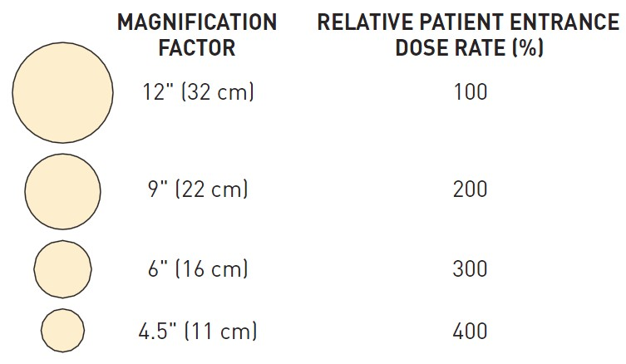

Invasive diagnostic coronary angiography
Figure 20
The effects of magnification on the radiation dose applied to the patients’ skin (permission Naber manuscript)
Guy R. Heyndrickx, Aaron Peace, Chrysafios Girasis, Christoph K. Naber, Patrick W. Serruys, Christos V. Bourantas
©2025 Europa Group - All rights reserved.

