Slide 1


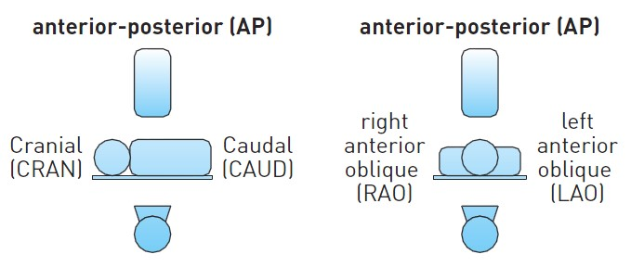

Invasive diagnostic coronary angiography
Figure 22
Definitions of angiographic projections (permission Naber manuscript)LAO: left anterior oblique; RAO: right anterior oblique; CRAN: cranial; CAUD: caudal; AP: anterior-posterior
Guy R. Heyndrickx, Aaron Peace, Chrysafios Girasis, Christoph K. Naber, Patrick W. Serruys, Christos V. Bourantas
©2025 Europa Group - All rights reserved.

