Slide 1


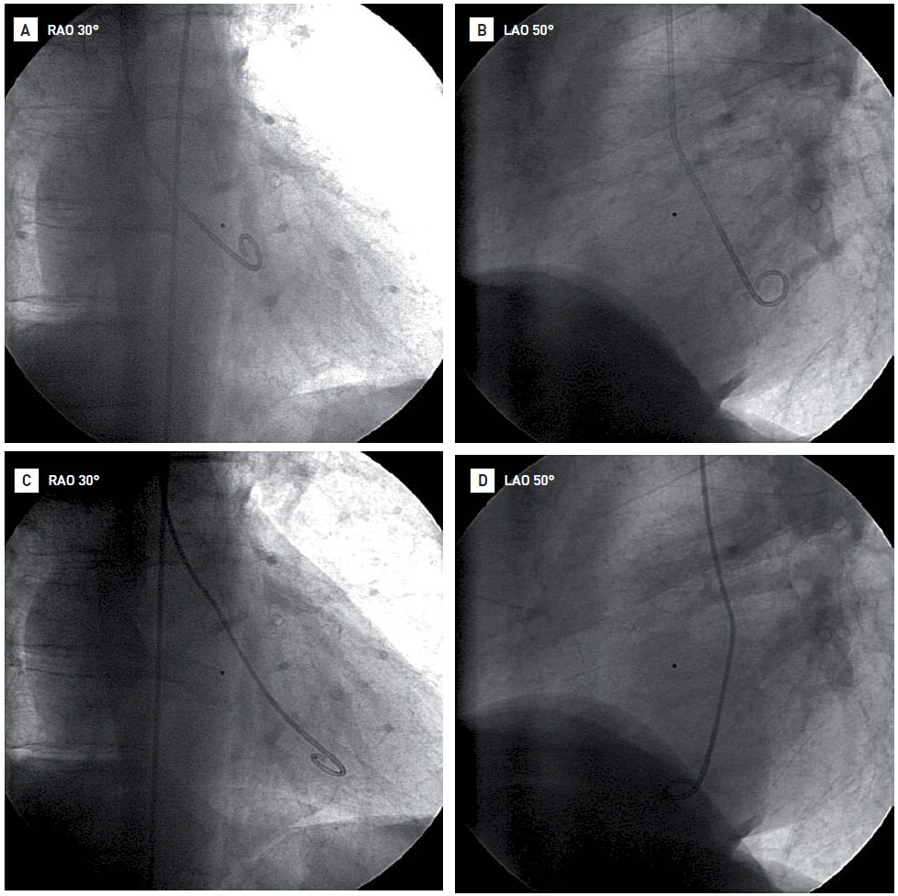

Invasive diagnostic coronary angiography
Figure 23
A (RAO projection) and B (LAO projection): correct position of the pigtail catheter in the mitral inflow tract of the left ventricleC (RAO projection) and D (LAO projection): incorrect position of the pigtail catheter in the apex of the left ventricle
Guy R. Heyndrickx, Aaron Peace, Chrysafios Girasis, Christoph K. Naber, Patrick W. Serruys, Christos V. Bourantas
©2025 Europa Group - All rights reserved.

