Slide 1


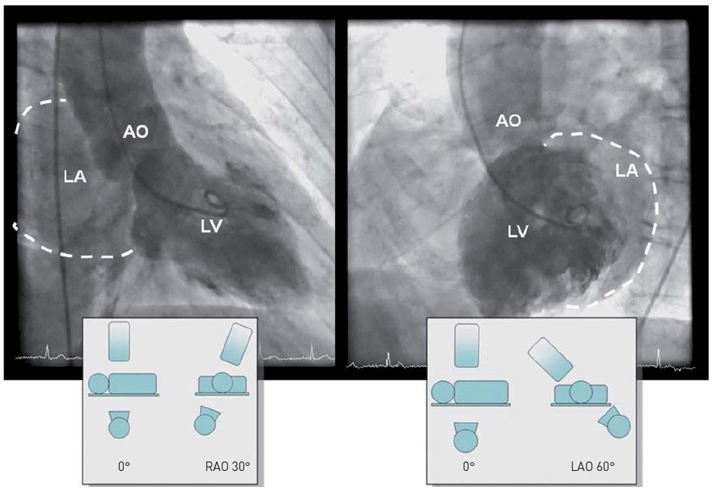

Invasive diagnostic coronary angiography
Figure 24
Standard views of the left ventricleLV: left ventricle; LA: left atrium; AO: aorta; LAO: left anterior oblique; RAO: right anterior oblique
Guy R. Heyndrickx, Aaron Peace, Chrysafios Girasis, Christoph K. Naber, Patrick W. Serruys, Christos V. Bourantas
©2025 Europa Group - All rights reserved.

