Slide 1


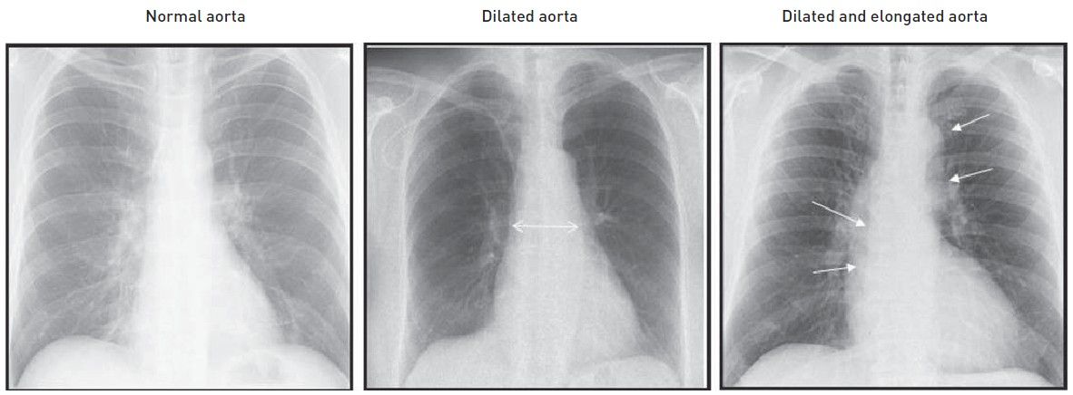

Invasive diagnostic coronary angiography
Figure 25
Coronary catheter selection in function of dilatation and elongation of the ascending aorta
Guy R. Heyndrickx, Aaron Peace, Chrysafios Girasis, Christoph K. Naber, Patrick W. Serruys, Christos V. Bourantas
©2025 Europa Group - All rights reserved.

