Slide 1


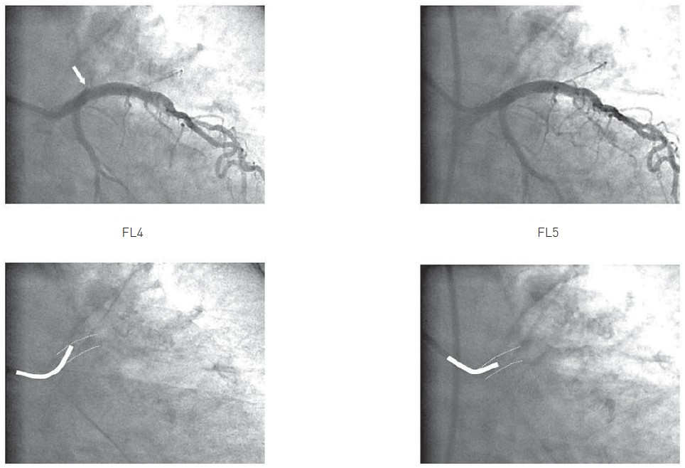

Invasive diagnostic coronary angiography
Figure 26
Example in the same patient of the seating of an FL4 (left panel) and an FL5 (right panel) diagnostic catheter in the left main. The FL4 catheter is definitely too short resulting in pointing in the roof of the left main coronary artery
Guy R. Heyndrickx, Aaron Peace, Chrysafios Girasis, Christoph K. Naber, Patrick W. Serruys, Christos V. Bourantas
©2025 Europa Group - All rights reserved.

