Slide 1


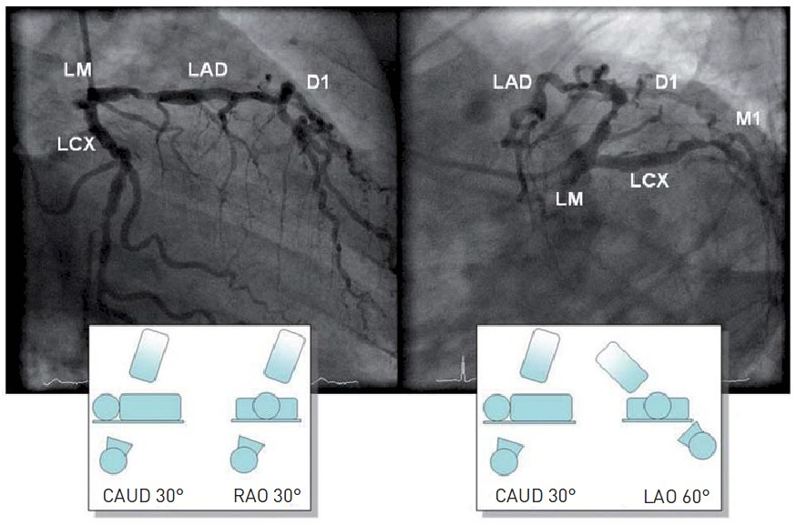

Invasive diagnostic coronary angiography
Figure 28
Caudal views of the left coronary arteryLM: left main; LAD: left anterior descending; LCX: left circumflex; D1: first diagonal; M1: first marginal; LAO: left anterior oblique; RAO: right anterior oblique; CAUD: caudal
Guy R. Heyndrickx, Aaron Peace, Chrysafios Girasis, Christoph K. Naber, Patrick W. Serruys, Christos V. Bourantas
©2025 Europa Group - All rights reserved.

