Slide 1


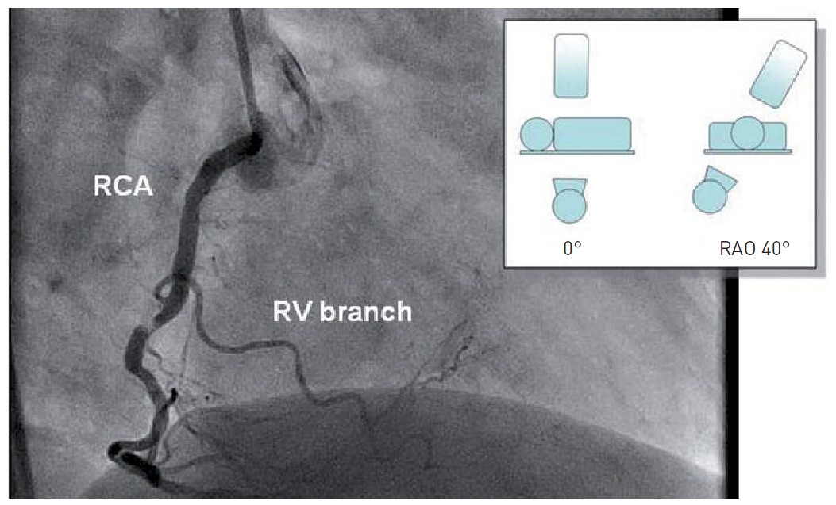

Invasive diagnostic coronary angiography
Figure 32
RAO view of the right coronary artery (permission Naber manuscript) (3)RCA: right coronary artery; RPLD: ramus posterolateralis dexter; RIVP: ramus interventricularis posterior; LAO: left anterior oblique; CRAN: cranial
Guy R. Heyndrickx, Aaron Peace, Chrysafios Girasis, Christoph K. Naber, Patrick W. Serruys, Christos V. Bourantas
©2025 Europa Group - All rights reserved.

