Slide 1


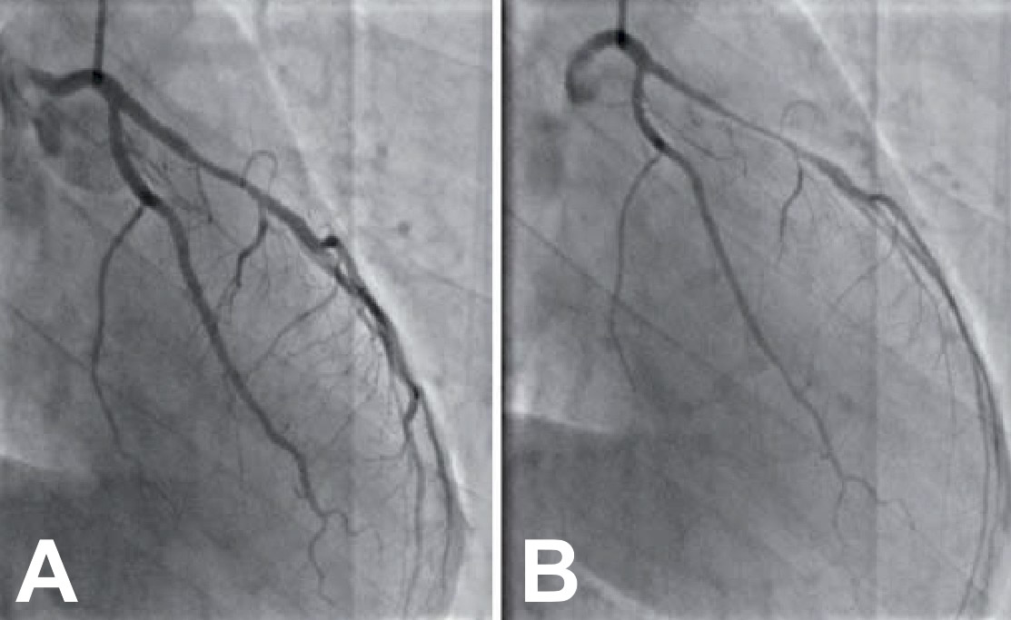

Invasive diagnostic coronary angiography
Figure 35
Ergonovine induced spasm. a) baseline angiogram, b) after ergonovine
Guy R. Heyndrickx, Aaron Peace, Chrysafios Girasis, Christoph K. Naber, Patrick W. Serruys, Christos V. Bourantas
©2025 Europa Group - All rights reserved.

