Slide 1


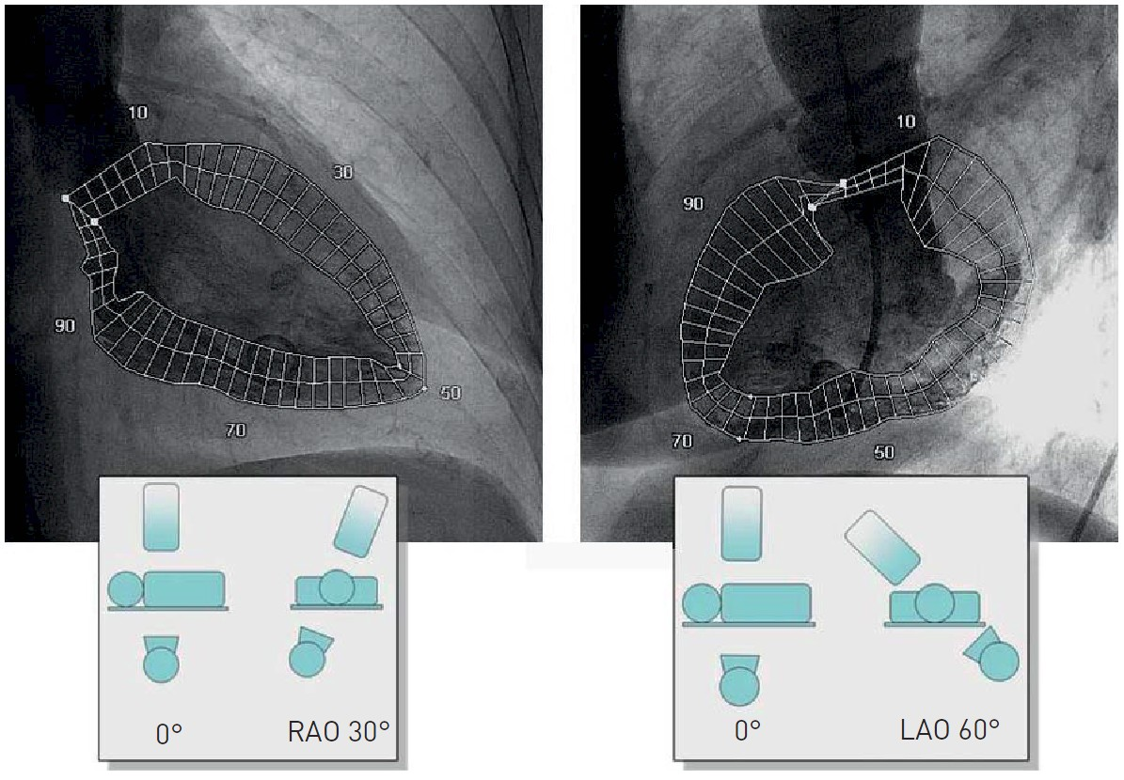

Invasive diagnostic coronary angiography
Figure 36
Regional wall motion during left ventriculography as assessed by automated contour detection (permission Naber manuscript)
Guy R. Heyndrickx, Aaron Peace, Chrysafios Girasis, Christoph K. Naber, Patrick W. Serruys, Christos V. Bourantas
©2025 Europa Group - All rights reserved.

