Slide 1


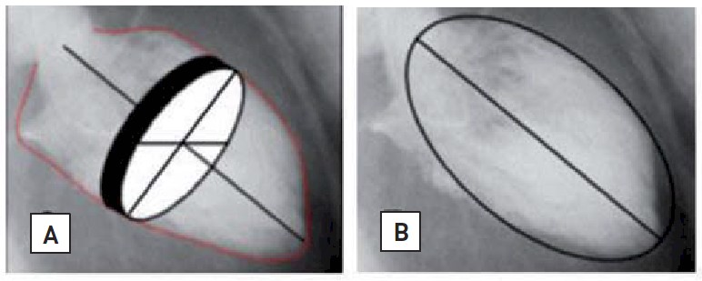

Invasive diagnostic coronary angiography
Figure 38
Analysis of global and regional left ventricle function using Simpson’s rule (left) and the Sandler Dodge area-length method (right)
Guy R. Heyndrickx, Aaron Peace, Chrysafios Girasis, Christoph K. Naber, Patrick W. Serruys, Christos V. Bourantas
©2025 Europa Group - All rights reserved.

