Slide 1


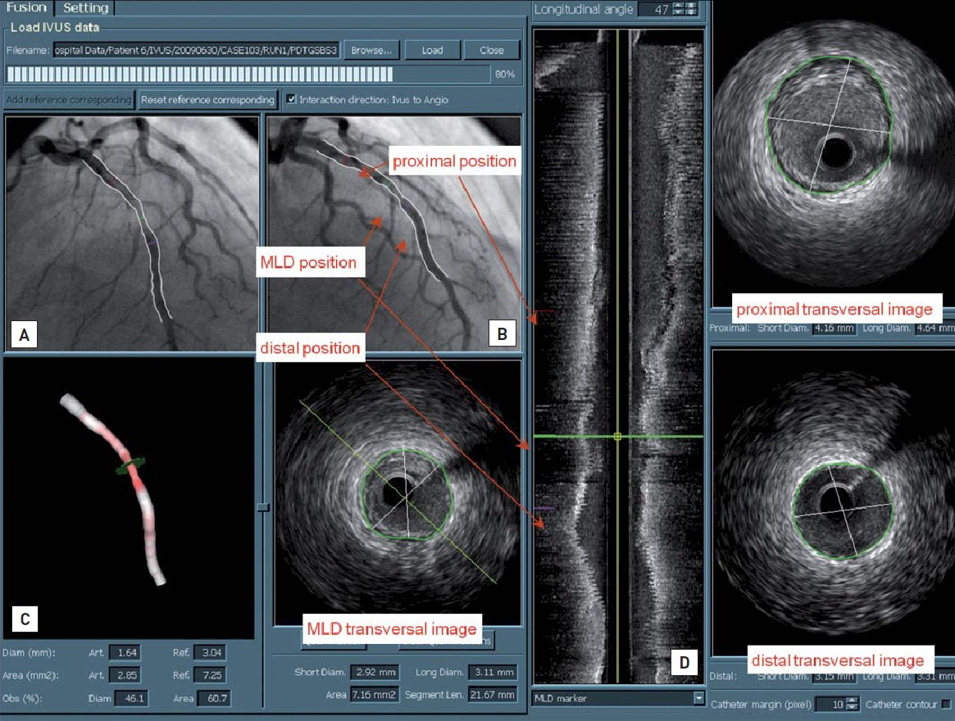

Invasive diagnostic coronary angiography
Figure 41
Angiography-IVUS co-registration and quantification.A common baseline reference point (i.e., side branch) was identified in both images (angiographic and IVUS), in order to co-register the two imaging modalities. Two 2D angiographic images (A and B) are reconstructed into a 3D image (C) of the vessel segment studied. Markers of the proximal distal and MLD position are synchronised with corresponding markers superimposed on the IVUS longitudinal view (D); thereby, corresponding measurements for IVUS and 3D QCA can be compared. Courtesy of Department of Applied Research, Medis B.V. and Department of Radiology, Leiden University Medical Centre.
Guy R. Heyndrickx, Aaron Peace, Chrysafios Girasis, Christoph K. Naber, Patrick W. Serruys, Christos V. Bourantas
©2025 Europa Group - All rights reserved.

