Slide 1


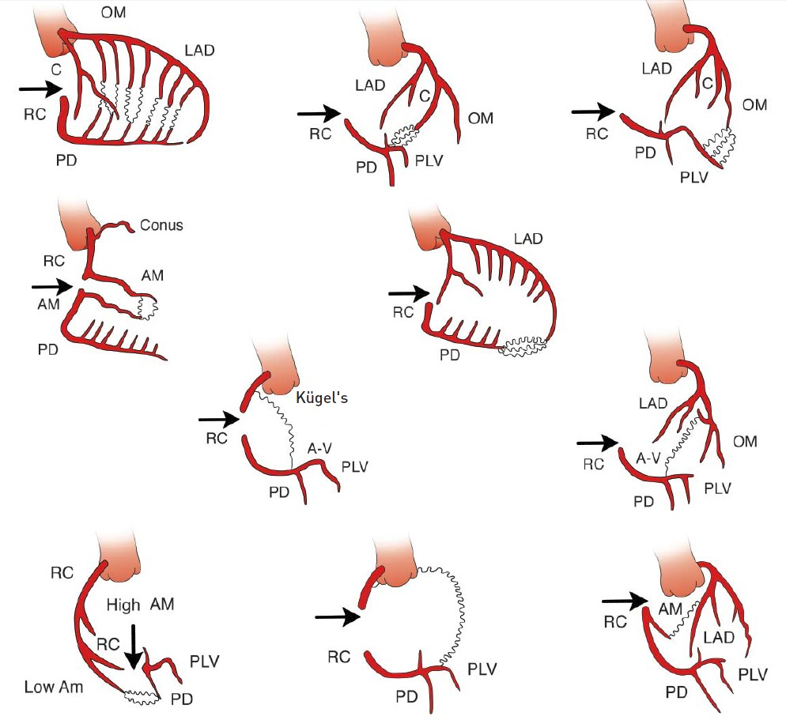

Invasive diagnostic coronary angiography
Figure 8
Common collateral pathways observed with right anterior descending artery occlusionThe arrows point to the site of the occlusion. The small tortuous channels represent the collateral connection. LAD: left anterior descending coronary artery; RC: right coronary artery; C: circumflex artery; OM: obtuse marginal branch of the circumflex artery; PD: posterior descending branch; AM: acute marginal branch from the RCA; A-V: artery to the atrioventricular; PLV: posterolateral branch (permission Braunwald Textbook).
Guy R. Heyndrickx, Aaron Peace, Chrysafios Girasis, Christoph K. Naber, Patrick W. Serruys, Christos V. Bourantas
©2025 Europa Group - All rights reserved.

