Slide 1


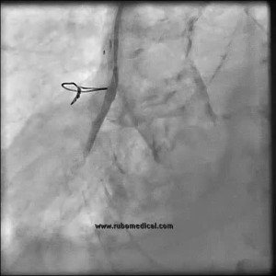

Invasive diagnostic coronary angiography
Moving image 10
60° LAO projection; selective injection in a saphenous vein graft to the right coronary artery.
Guy R. Heyndrickx, Aaron Peace, Chrysafios Girasis, Christoph K. Naber, Patrick W. Serruys, Christos V. Bourantas
©2025 Europa Group - All rights reserved.

