Slide 1


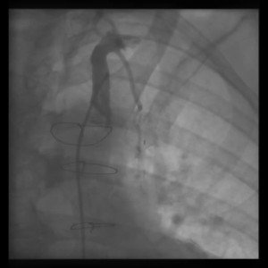

Invasive diagnostic coronary angiography
Moving image 12
90° LAO projection; selective injection in the left subclavian artery and semi-selective angiography of the left internal mammary artery graft to the left anterior descending artery.
Guy R. Heyndrickx, Aaron Peace, Chrysafios Girasis, Christoph K. Naber, Patrick W. Serruys, Christos V. Bourantas
©2025 Europa Group - All rights reserved.

