Slide 1


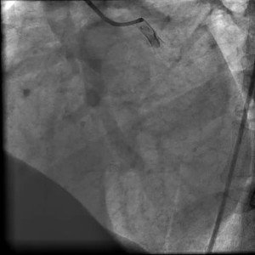

Invasive diagnostic coronary angiography
Moving image 17
Coronary injection of LCA after ic nitrates.
Guy R. Heyndrickx, Aaron Peace, Chrysafios Girasis, Christoph K. Naber, Patrick W. Serruys, Christos V. Bourantas
©2025 Europa Group - All rights reserved.

