Slide 1


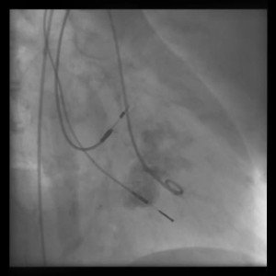

Invasive diagnostic coronary angiography
Moving image 24
Calcification of the mitral ring with mitral regurgitation.
Guy R. Heyndrickx, Aaron Peace, Chrysafios Girasis, Christoph K. Naber, Patrick W. Serruys, Christos V. Bourantas
©2025 Europa Group - All rights reserved.

