Slide 1


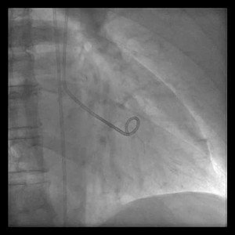
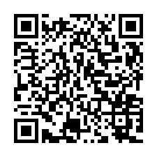
Invasive diagnostic coronary angiography
Moving image 35
Tako-Tsubo: resolution after 1 week.
Guy R. Heyndrickx, Aaron Peace, Chrysafios Girasis, Christoph K. Naber, Patrick W. Serruys, Christos V. Bourantas
©2025 Europa Group - All rights reserved.

