Slide 1


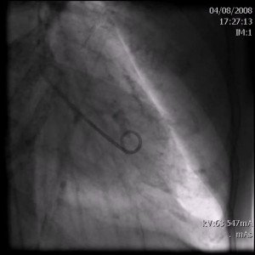

Invasive diagnostic coronary angiography
Moving image 37
Ventriculography in the right anterior oblique projection showing the contour of the anomalous circumflex artery (arrow) passing behind the right coronary aortic sinus.This is known as the aortic root sign or Page’s sign.
Guy R. Heyndrickx, Aaron Peace, Chrysafios Girasis, Christoph K. Naber, Patrick W. Serruys, Christos V. Bourantas
©2025 Europa Group - All rights reserved.

