Slide 1


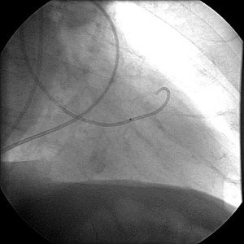

Invasive diagnostic coronary angiography
Moving image 38
RAO 30ÃÅ¡ projection; injection into the free wall of the left ventricle as a consequence of an improper location of the pigtail catheter.Contrast filling of the pericardium with no hemodynamic consequences.
Guy R. Heyndrickx, Aaron Peace, Chrysafios Girasis, Christoph K. Naber, Patrick W. Serruys, Christos V. Bourantas
©2025 Europa Group - All rights reserved.

