Slide 1


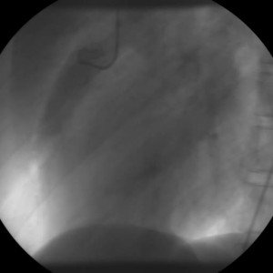

Invasive diagnostic coronary angiography
Moving image 5
Bland-White-Garland syndrome with origin of the LCA from the pulmonary artery. LAT.
Guy R. Heyndrickx, Aaron Peace, Chrysafios Girasis, Christoph K. Naber, Patrick W. Serruys, Christos V. Bourantas
©2025 Europa Group - All rights reserved.

