Slide 1


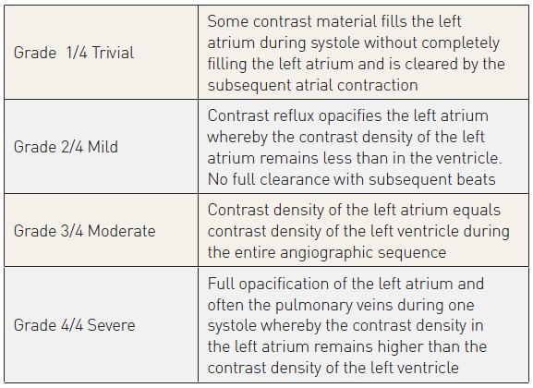

Invasive diagnostic coronary angiography
Table 10
Classification of mitral regurgitation
Guy R. Heyndrickx, Aaron Peace, Chrysafios Girasis, Christoph K. Naber, Patrick W. Serruys, Christos V. Bourantas
©2025 Europa Group - All rights reserved.

