Slide 1


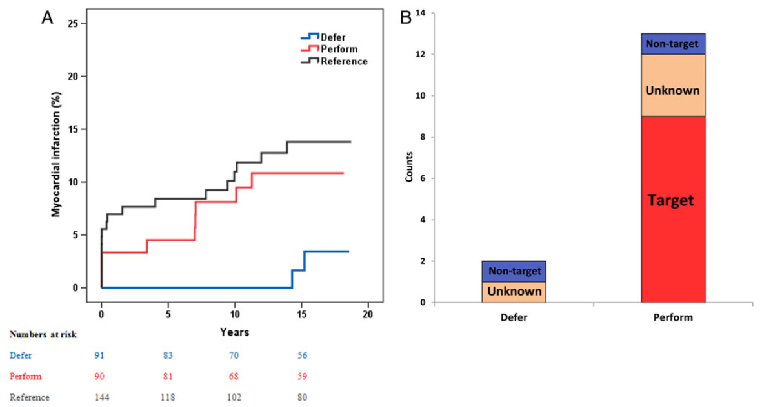

Invasive physiological assessment of coronary disease (FFR)
Figure 1
Myocardial infarction rates after 15 years, for patients with single vessel coronary artery disease. The blue and red line represent patients without inducible myocardial ischaemia (as assessed by Fractional Flow Reserve), treated by medical therapy or PCI (stent placement), respectively. The black line represents patients who do have inducible ischaemia, treated by PCI in combination with optimal medical therapy. On the right, the relation of myocardial infarction with target vessel territory is shown (reference 14)
Pim A.L. Tonino, Nico H.J. Pijls, Danielle C.J. Keulards
©2025 Europa Group - All rights reserved.

