Slide 1


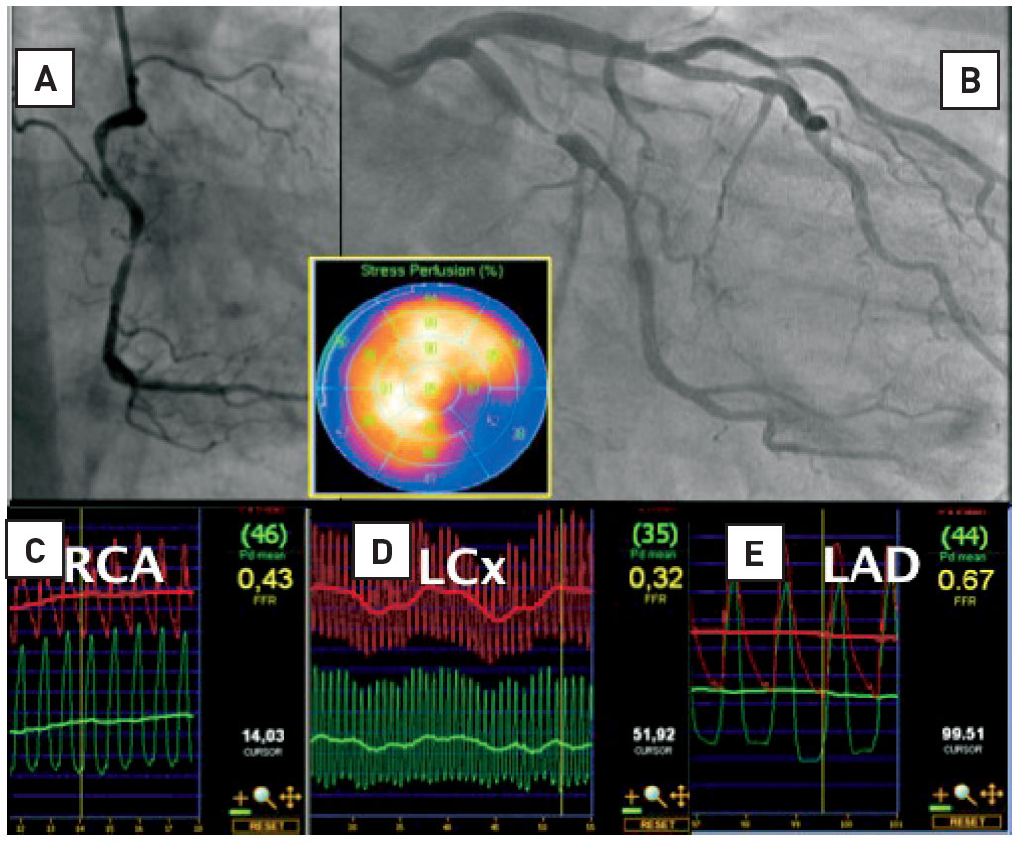

Invasive physiological assessment of coronary disease (FFR)
Figure 10
Multivessel disease and nuclear imaging : risk of ‘balanced’ ischaemia. Patient with severe angina. Myocardial perfusion imaging (MPI) showed a reversible defect in the inferolateral segments. From the angiogram it is obvious that the right coronary artery (RCA) and the left circumflex artery (RCX) are significantly narrowed. However, the mid left anterior descending artery (LAD) stenosis, considered “non-significant” on the angiogram, appears to be hemodynamically signifcant. This LAD stenosis was undetected by MPI because the uptake of tracer is markedly worse in the RCX territory than in the LAD territory. Therefore, ischemia in the anterior wall is masked by more severe ischemia in the lateral/inferior wall.
Pim A.L. Tonino, Nico H.J. Pijls, Danielle C.J. Keulards
©2025 Europa Group - All rights reserved.

