Slide 1


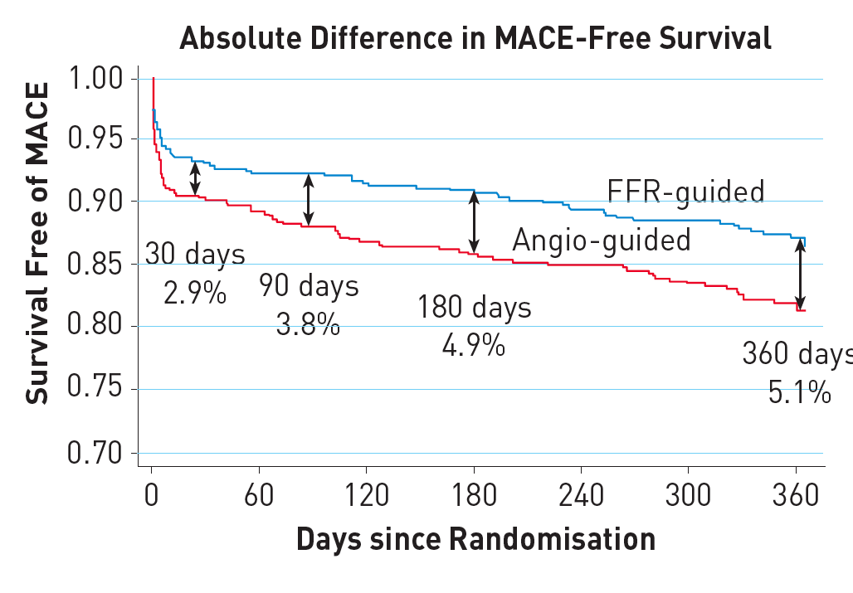

Invasive physiological assessment of coronary disease (FFR)
Figure 11
Survival curves in the landmark FAME study. Kaplan-Meier curve showing survival free from MACE at 1 year, which was the primary endpoint in the Fractional Flow Reserve versus Angiography in Multivessel Evaluation (FAME) study. The international, multicentre FAME study compared angiography-guided PCI to FFRguided PCI in patients with multivessel coronary artery disease in a randomised fashion. FFR-guided PCI significantly reduced the primary endpoint (p=0.02)). (reference 32). Differences persisted at 2 years and at 5 years follow up (reference 54).
Pim A.L. Tonino, Nico H.J. Pijls, Danielle C.J. Keulards
©2025 Europa Group - All rights reserved.

