Slide 1


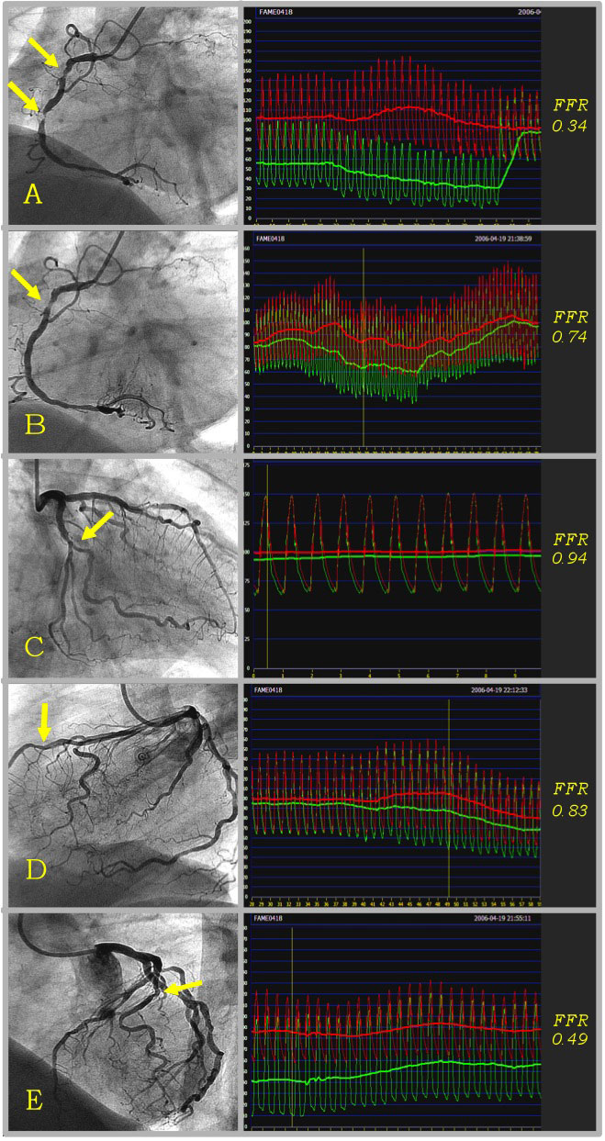

Invasive physiological assessment of coronary disease (FFR)
Figure 12
Example of FFR in multivessel coronary disease. Example of a FAME study patient, treated by FFR-guided PCI. This patient had 5 stenoses that were indicated by the operator as requiring stent placement on the basis of the angiogram and clinical data. Thereafter this patient with multivessel coronary artery disease was randomised to the FFR-guided strategy, which means that only stenoses with FFR ≤ 0.80 (below the ischaemic threshold) are to be stented. FFR of the 2 tight stenoses in the RCA was 0.34 (Panel A). A stent was placed in the distal stenosis, and FFR thereafter was 0.74 (Panel B). A second stent was placed in the proximal stenosis (FFR after stenting of the RCA was 0.87). FFR of the RCX was 0.94 (Panel C), and this stenosis was therefore not stented. The 50-70% stenosis in the LAD was also not stented because of an FFR above the ischaemic threshold of 0.80 (Panel D). The FFR of the 50-70% stenosis in the diagonal branch was 0.49 (Panel E), and a stent was placed with a good angiographic result (FFR after stenting in the diagonal was not recorded). The total procedure time was 46 minutes. Only 3 out of the 5 indicated stenoses needed stent placement after assessment by FFR.
Pim A.L. Tonino, Nico H.J. Pijls, Danielle C.J. Keulards
©2025 Europa Group - All rights reserved.

