Slide 1


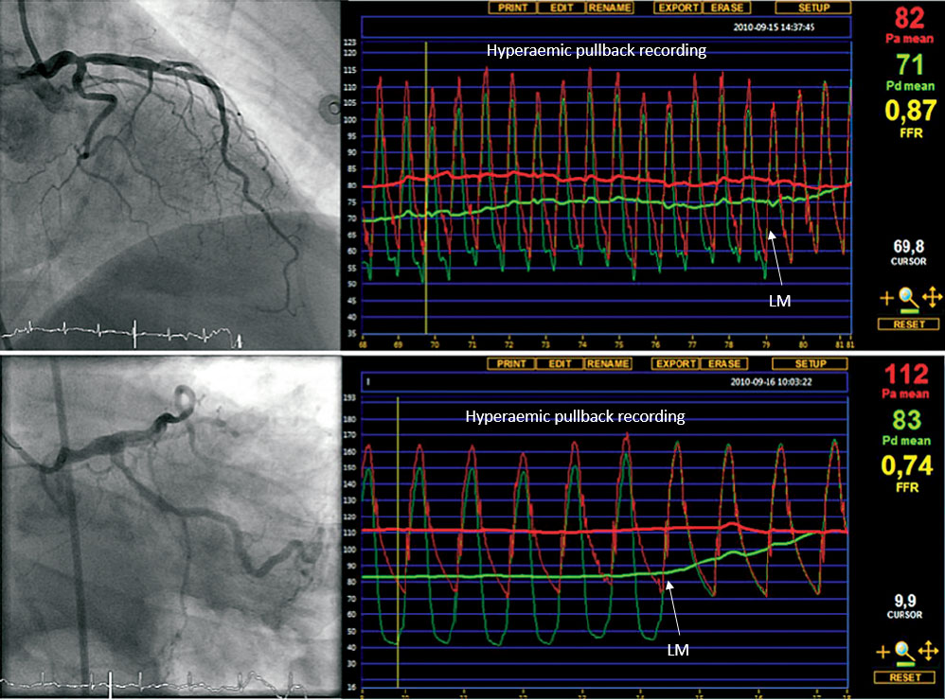

Invasive physiological assessment of coronary disease (FFR)
Figure 13
Example of FFR in left main disease. Example of two patients in whom fractional flow reserve (FFR) measurements in an angiographically intermediate left main stenosis changed the therapeutic strategy. The first (upper panel) represents a 61-year old female patient. Her exercise test was non-conclusive and her nuclear scan result was unclear, showing possible apical ischaemia. She was referred for bypass surgery because of a distal left main stenosis. Before making a decision about revascularisation, FFR was performed. FFR was 0.87, indicating that the left main stenosis is not responsible for myocardial ischaemia. The patient was treated by medical therapy, instead of bypass surgery and had an excellent follow up.The second (lower panel) represents a 76-year old male with typical chest pain. Nuclear scan showed ischaemia inferolateral. The patient was referred for PCI of the proximal RCX. However, when making additional diagnostic angiographic views of the left coronary artery in the PCI centre, an intermediate mid left main stenosis was visualised. FFR was measured (pressure sensor in LAD) and it revealed (FFR 0.74) a physiologically important left main stenosis. The therapeutic strategy was changed from PCI of the RCX to bypass surgery because of a significant left main stenosis.
Pim A.L. Tonino, Nico H.J. Pijls, Danielle C.J. Keulards
©2025 Europa Group - All rights reserved.

