Slide 1


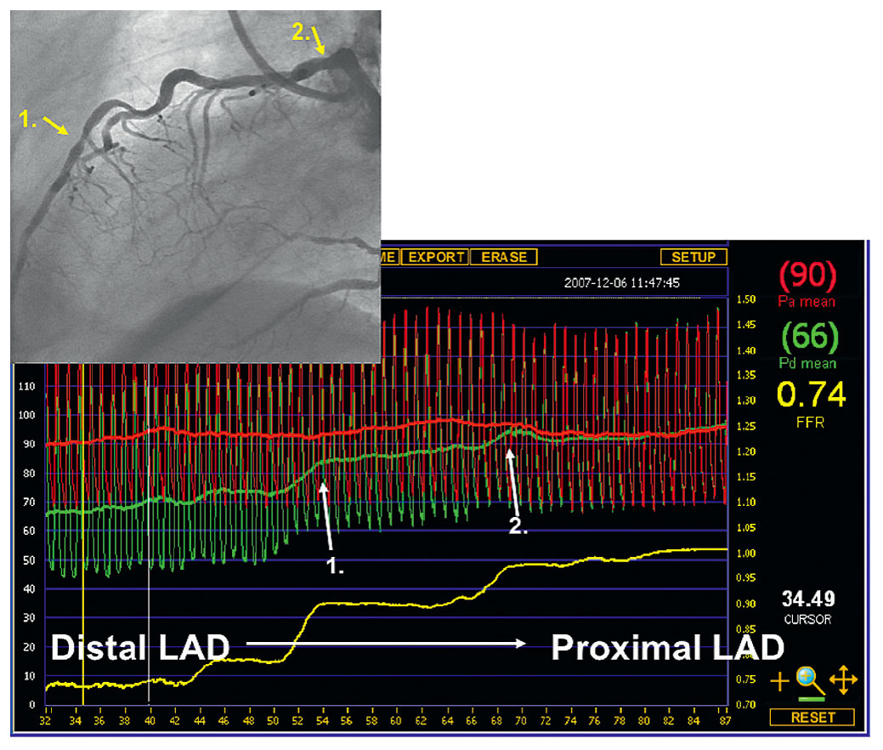

Invasive physiological assessment of coronary disease (FFR)
Figure 14
Hyperaemic pressure pull-back recording. Hyperaemic pressure pull-back recording in a diffusely diseased left anterior descending artery (LAD) with superimposed focal lesions. The distal Pd/Pa ratio in the LAD is 0.74 and represents the hemodynamic influence of all lesions taken together. The pressure pull back tracing under steady-state maximal hyperaemia nicely shows the exact origin of the gradient at the different spots (white arrows).
Pim A.L. Tonino, Nico H.J. Pijls, Danielle C.J. Keulards
©2025 Europa Group - All rights reserved.

