Slide 1


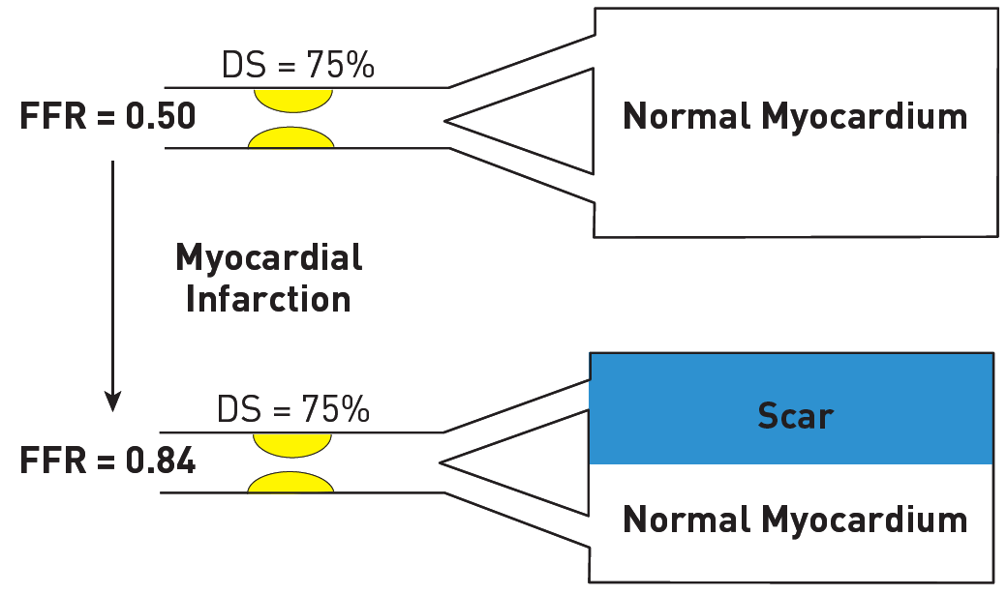

Invasive physiological assessment of coronary disease (FFR)
Figure 15
Relationship of FFR to myocardium subtended by an angiographic stenosis. Schematic representation of the relation between FFR and myocardial mass before and after myocardial infarction. Despite similar angiographic disease, the functional significance of the stenosis depends on the amount of viable myocardium. See text for details.
Pim A.L. Tonino, Nico H.J. Pijls, Danielle C.J. Keulards
©2025 Europa Group - All rights reserved.

