Slide 1


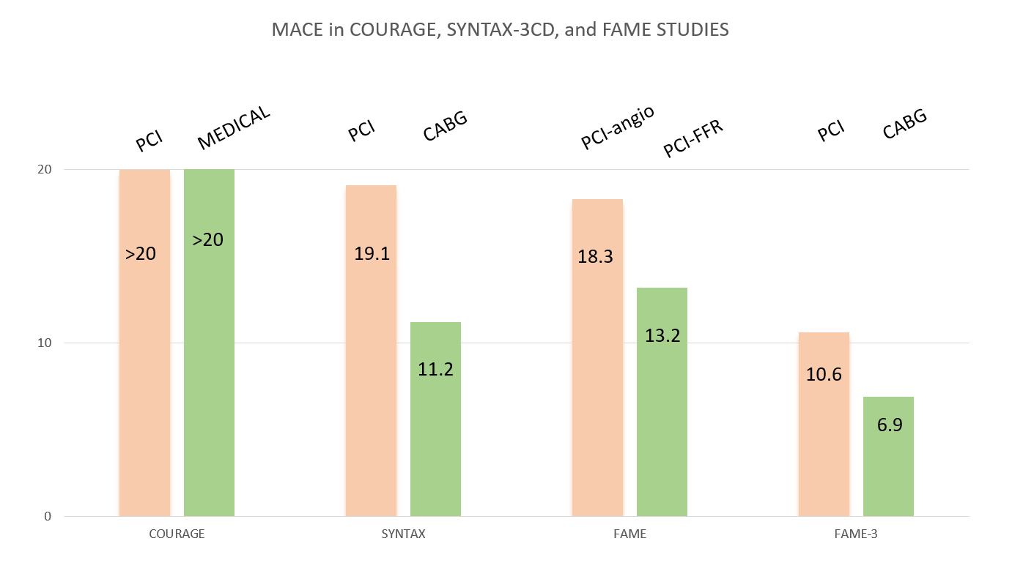

Invasive physiological assessment of coronary disease (FFR)
Figure 18
Adverse events reported in fourlandmark randomised trials on different treatment strategies for coronary disease. Major Adverse Event rate (death from all causes, myocardial infarction, and (repeated) revascularisation) in the COURAGE study, SYNTAX-3VD study, and FAME-2 and FAME-3 study. It is clear that in patients with multivessel coronary disease, FFR guided PCI is superior to standard angiography guided PCI. In Addition, considering that the population in Syntax and FAME-3 were comparable, it can be observed that even in complex 3-VD, FFR guided PCI and using second generation of DES (as used in FAME-3) has improved PCI outcome and decreased MACE rate from 18.3% to 13.2% and is equal to CABG outcome in the Syntax study. But also CABG outcome has significantly improved over the last decade and for patients with 3VD and high SS, CABG remains the treatment of choice.Note: the exact MACE rate in the Courage trial at 1 year has not been published, but from published data a MACE rate exceeding 20% can be deduced (reference 7, 31, 80).
Pim A.L. Tonino, Nico H.J. Pijls, Danielle C.J. Keulards
©2025 Europa Group - All rights reserved.

