Slide 1


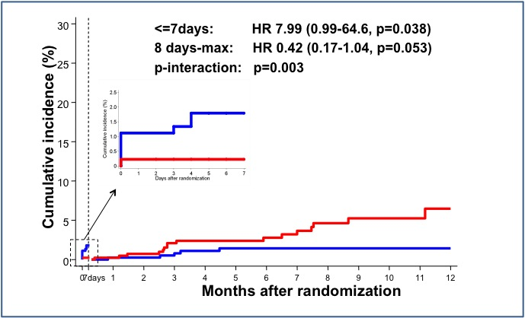
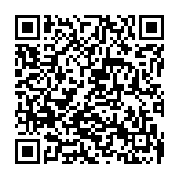
Invasive physiological assessment of coronary disease (FFR)
Figure 19
Kaplan-Meier plot of landmark analysis of death or myocardial infarction in FAME 2. Red curve represents the Optimal Medical Therapy alone (OMT) group and blue curve represents FFR-guided PCI group. In the first 7 days after randomization the rate of death or myocardial infarction in the PCI-group due to procedure-related events. Landmark analysis from 8 days after randomization shows diverging curves in favor of the FFR-guided PCI group. These favorable results persisted at 2 and 5 years (reference 54).
Pim A.L. Tonino, Nico H.J. Pijls, Danielle C.J. Keulards
©2025 Europa Group - All rights reserved.

