Slide 1


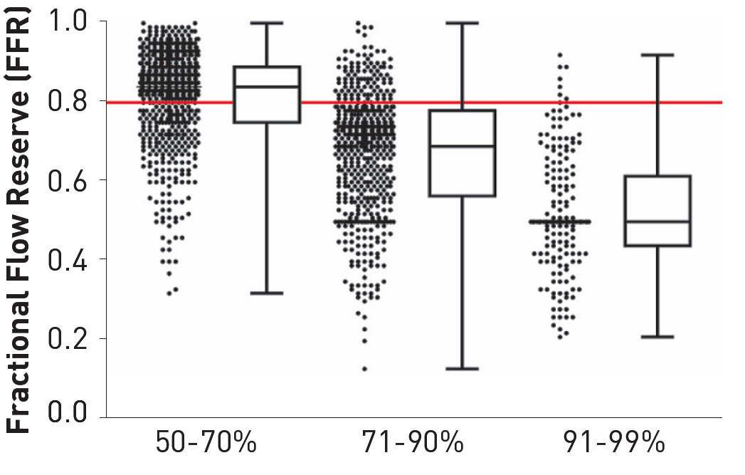

Invasive physiological assessment of coronary disease (FFR)
Figure 2
Angiographic severity versus functional severity of coronary artery stenosis in the FAME study. Box-and-Whisker plot showing the FFR values of the lesions in the categories of 50-70%, 71-90%, and 91-99% diameter stenosis, as visually estimated on the basis of the angiogram. In the category 50-70% stenosis, 35% was functionally significant (FFR ≤0.80) and 65% was not (FFR >0.80). In the category 71-90% stenosis, 80% was functionally significant and 20% was not. In the category of subtotal stenoses, >95% was functionally significant (reference 31).
Pim A.L. Tonino, Nico H.J. Pijls, Danielle C.J. Keulards
©2025 Europa Group - All rights reserved.

