Slide 1


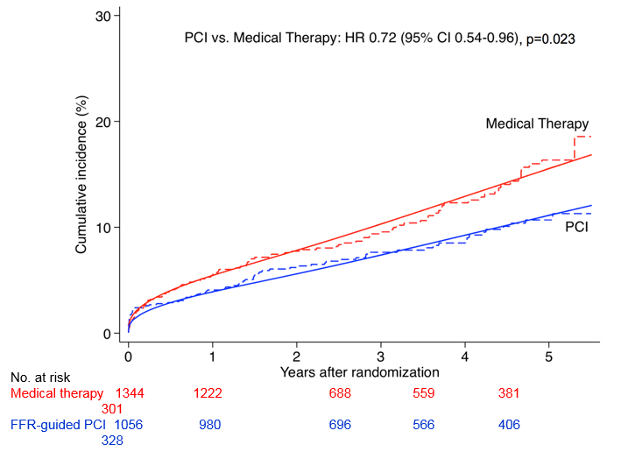

Invasive physiological assessment of coronary disease (FFR)
Figure 20
Cumulative incidence curves of primary composite outcome of cardiac death or myocardial infarction from the recent large meta-analysis by Zimmermann (reference 12). As seen in this figure, FFR guided PCI, (i.e. performed for the correct indications) not only effectively improves quality of life, but also decreases combined hard endpoints of death and MI significantly.
Pim A.L. Tonino, Nico H.J. Pijls, Danielle C.J. Keulards
©2025 Europa Group - All rights reserved.

