Slide 1


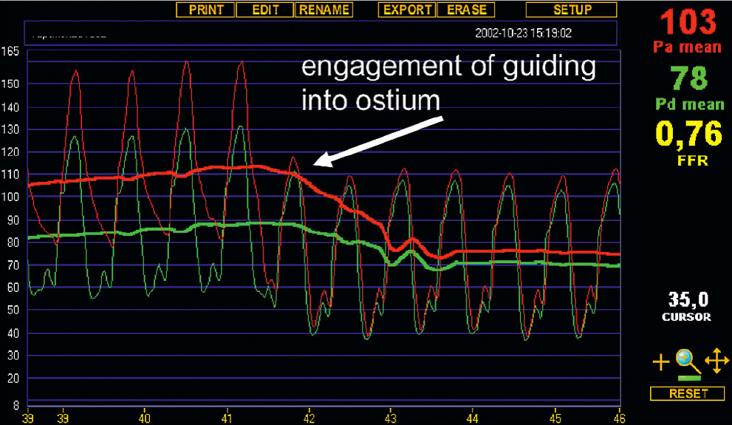

Invasive physiological assessment of coronary disease (FFR)
Figure 21
Example of artefactual change in FFR. Illustration of the effect on pressure tracings of engagement of the guiding catheter into the coronary ostium. Both Pd (distal pressure as measured by the pressure sensor) and Pa (proximal pressure as measured by the guiding catheter) become lower when the guiding catheter “blocks” the ostium of the coronary artery. Particularly Pa lowers and the shape of its curve becomes identical to the Pd curve, which makes such a “pitfall” situation easily recognizable in clinical practice. By simply dislodging the guiding catheter slightly from the ostium this potential ‘pitfall’ can be avoided
Pim A.L. Tonino, Nico H.J. Pijls, Danielle C.J. Keulards
©2025 Europa Group - All rights reserved.

