Slide 1


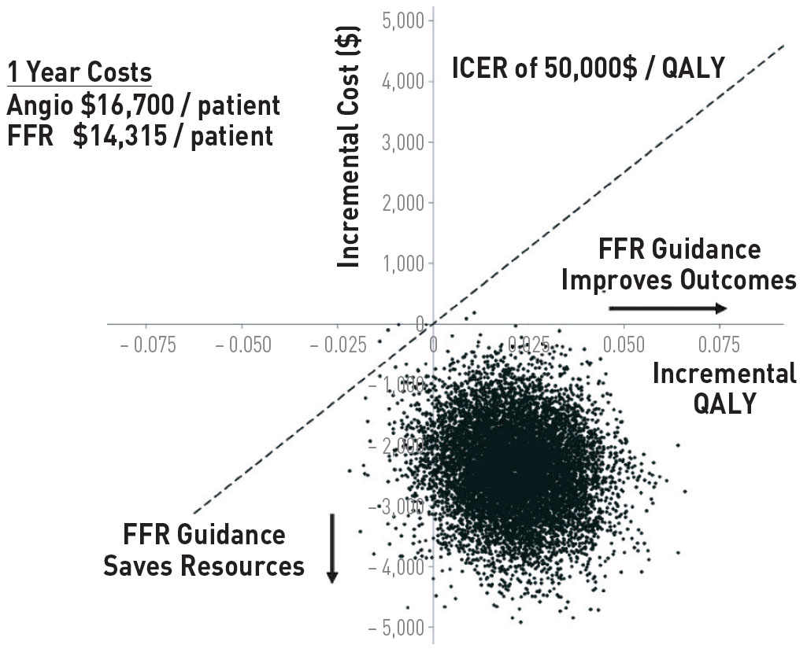

Invasive physiological assessment of coronary disease (FFR)
Figure 22
Cost-effectiveness of an FFR guided approach to PCI. Bootstrap simulation of incremental costs and effects. Numbers on axes represent differences between FFR-guided and angiography guided strategies. Positive incremental quality adjusted life-years (QALYs) indicate higher effectiveness for FFR-guided treatment. Negative incremental costs indicate lower costs for FFR-guided treatment compared with angiography-guided strategy. Bootstrap simulation indicated that the FFR-guided strategy was cost-saving in 90.74% and cost-effective at a threshold of US $50 000 per quality-adjusted life years in 99.96%. Data are from 5000 bootstrap Replications (reference 53)
Pim A.L. Tonino, Nico H.J. Pijls, Danielle C.J. Keulards
©2025 Europa Group - All rights reserved.

