Slide 1


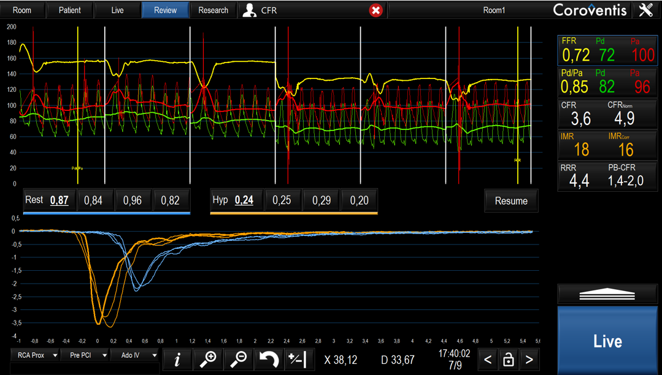

Invasive physiological assessment of coronary disease (FFR)
Figure 23
Screenshot with an example of an IMR/CFR measurement. The green and red line represent the Pd and Pa respectively. The blue and orange curves at the bottom panel represent the temperature changes following a bolus injection of 3ml saline during rest and hyperemia respectively. After inducing hyperemia the mean transit time (Tm) is obtained. The indexes are directly calculated by the Coroventis software program. The CFR is determined by dividing the mean resting blood flow (blue lines, Tm,rest) and mean hyperaemic blood flow (orange lines, Tm,hyp). The IMR is calculated by multiplying the Pd with the mean hyperaemic blood flow (Tm,hyp).
Pim A.L. Tonino, Nico H.J. Pijls, Danielle C.J. Keulards
©2025 Europa Group - All rights reserved.

