Slide 1


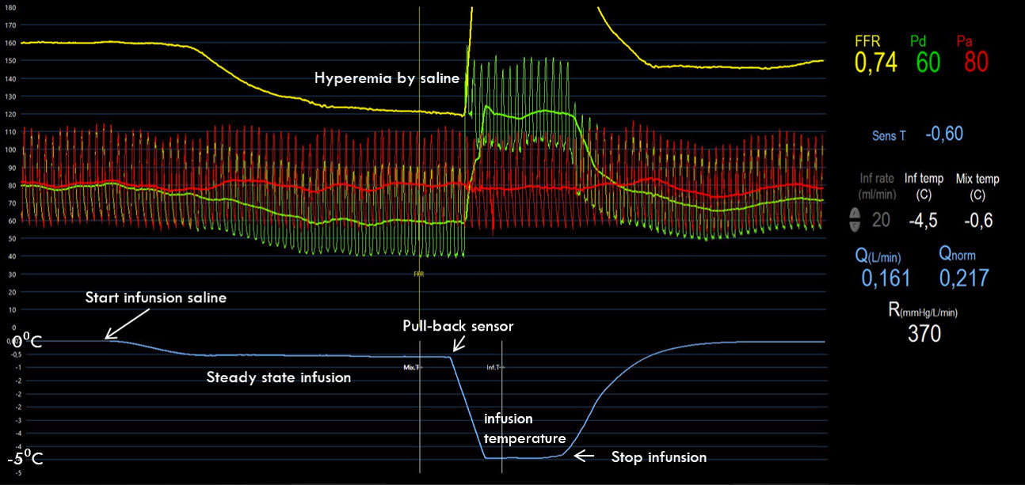

Invasive physiological assessment of coronary disease (FFR)
Figure 24
Screenshot with an example of an absolute flow measurement during saline-induced hyperemia. The green and red line represent the Pd and Pa respectively. The steady state of hyperemia is caused by the infusion of saline through the Rayflow®. The blue line represents the distal infusion temperature. After this reaches steady state, the pressure wire is pulled back in the Rayflow® creating a fast decrease of the temperature curve and possibility to registrate the infusion temperature. Afterwards the infusion pump is stopped and all values in the right panel are calculated directly by the Coroventis® software. Similar recordings can be made at rest with a saline infusion rate of 10 ml/min. From the resting and hyperemic measurement, also alsolute CFR and microvascular resistance reserve (MRR) can be calculated by the software.
Pim A.L. Tonino, Nico H.J. Pijls, Danielle C.J. Keulards
©2025 Europa Group - All rights reserved.

