Slide 1


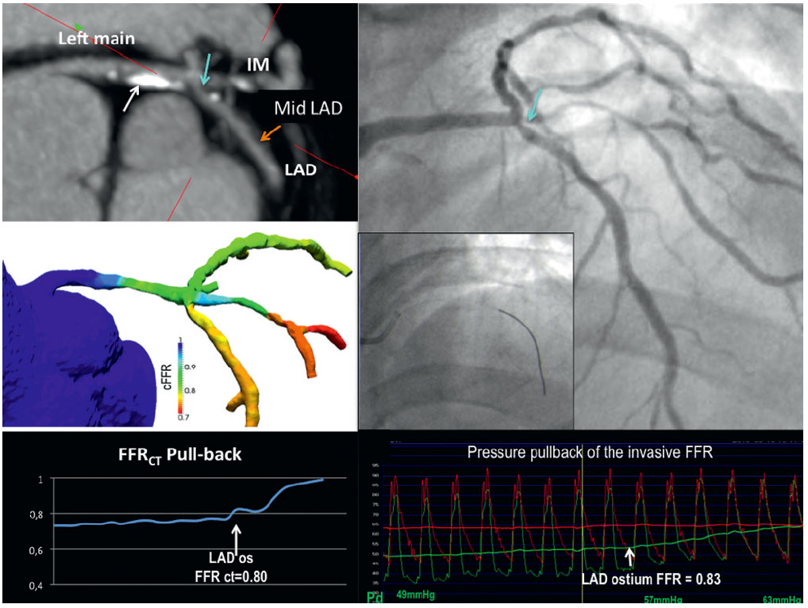

Invasive physiological assessment of coronary disease (FFR)
Figure 25
An example of non-invasive fractional flow reserve (FFR) based on multi-slice computed tomography (MSCT) and invasive FFR. Multi-planar reconstruction of MSCT (panel A) showed sequential lesions from the left main trunk (LM) to the left anterior descending artery (LAD): i) mild stenosis with a calcified plaque in LM (white arrow), ii) intermediate stenosis at the ostium of left circumflex immediately after trifurcation (light blue arrow), and iii) mild stenosis in the mid LAD (orange arrow). Non-invasive FFR based on the static MSCT images (FFRCT) in the left coronary arteries was color-coded and shown in panel B. The virtual pullback of noninvasive FFR from the distal LAD to the LM demonstrated a FFRCT of 0.80 at the ostium of LAD (panel C). Invasive angiography (panel D) showed an intermediate stenosis at the ostium of LAD (light blue arrow) and invasive FFR was performed (panel E). The pressure pullback of the invasive FFR showed an FFR of 0.83 at the ostium of LAD (panel F).
Pim A.L. Tonino, Nico H.J. Pijls, Danielle C.J. Keulards
©2025 Europa Group - All rights reserved.

